Slide 1
College Score Card Ranking
Final Project
Tufang Xu
Yier Yin

Slide 2

Introduction
College Score Card Ranking is a College-Recommendation Program that provides the top 5 best-fit colleges for high schoolers.

Slide 3

Our Mission
The purpose of our project is to help high school students to decide which colleges fit them the most.
By users’ inputs, we will evaluate accordingly and provide TOP 5 College Recommendation for the students for their references.

Slide 4
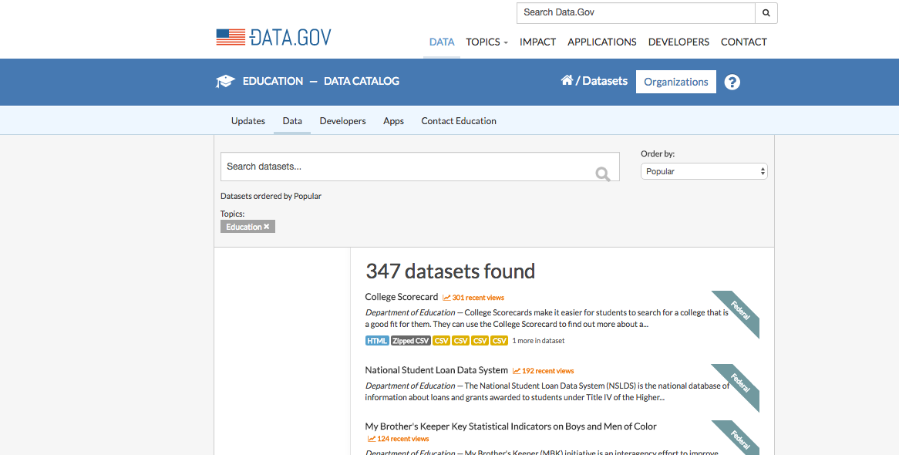
Data Collection
We based our data from Data.gov
The Data provides all the US Colleges’ information from 1994 – 2015.
Data File Link:
https://catalog.data.gov/dataset/college-scorecard/resource/b8f3d10b-0974-40db-b5fa-3c87ecae516b

Slide 5
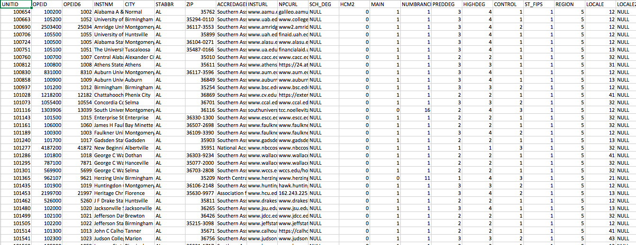
Raw Data Set
A glance of what our original dataset looks like…

Slide 6
Program Instruction
College Recommendation Panel (3 inputs)
College Acceptance Rate Panel (1 input)

Slide 7
College Recommendation Panel (3 input steps)
User Input Panel:
This channel allows users to type their identities (international, local, transfer)
The panel output will show the 5 top universities’ information recommended for the users according to their input
Output Panel:
We evaluate different students’ types in different methods – see input panel)

Slide 8
Program Instruction
College Acceptance Rate Trend
This panel helps to identify a university’s acceptance rate trend from 2004 - 2015

Slide 9
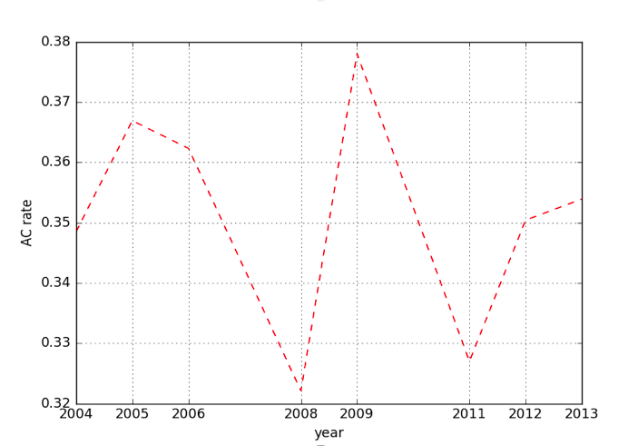
College Acceptance Rate Trend
Input:
Recommend collage or check accept rate ? R or A or Exit: A
Enter University Name: New York University
Output: (plot)

Slide 10
Project Problems and Evaluation
Large Dataset
To filter the schools’ lists, we need to limit from 9000 to around 2000-3000 rows, then we calculate the influence score methods to rank and recommend the top 5 best-suited school for the users.
Unorganized, Redundant columns and rows
Although it is an accurate dataset comes from the data.gov/education, we still find a bunch of not so accurate data in the data set in the form of “null”, “0” and other so on, so we filtered out these kind of useless data

Slide 11

Thank You!

